Slide 1
Foundations of Complex Software Architectures and Styles
Damian A. Tamburri, Ph.D.
damianandrew.tamburri@polimi.it
dtamburri@acm.org

Slide 2
Software Design Description (SDD)
The IEEE Standard for Information Technology—Systems Design—Software Design Descriptions
“Describes software designs and establishes the information content and organization of a software design description.”
“An SDD is a representation of a software design to be used for recording design information and communicating that design information to key design stakeholders.”
The IEEE Standard for Systems and software engineering — Architecture description
Is aligned with the previous one and
Specifies “the manner in which architectural descriptions of systems are organized and expressed”

Slide 3
The key concepts of a SDD according to the IEEE standard (1)

Slide 4
The key concepts of a SDD according to the IEEE standard (2)

Slide 5
The required contents of an SDD according to the IEEE standard
Identification of the SDD
Identified design stakeholders
Identified design concerns
Selected design viewpoints, each with type definitions of its allowed design elements and design languages
Design views
Design overlays
Design rationale

Slide 6
The required contents of an SDD according to the IEEE standard
Identification of the SDD
Identified design stakeholders
Identified design concerns
Selected design viewpoints, each with type definitions of its allowed design elements and design languages
Design views
Design overlays
Design rationale

Slide 7
Views and Viewpoints
Generally, it is not feasible to capture everything we want to model in a single model or document
The model would be too big, complex, and confusing
So, we create several coordinated models, each capturing a subset of the design decisions
Generally, the subset is organized around a particular concern or other selection criteria
We call the subset-model a ‘view’ and the concern (or criteria) a ‘viewpoint’

Slide 8
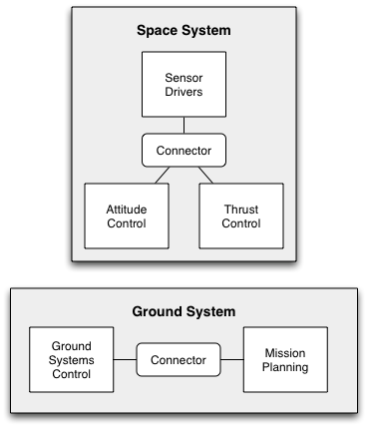
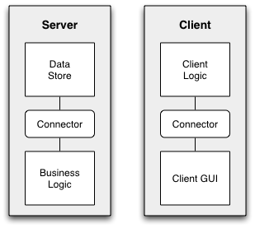
Views and Viewpoints Example
Deployment view of a 3-tier application
Deployment view of a Space Station system
Both instances of the deployment viewpoint
Software Architecture: Foundations, Theory, and Practice; Richard N. Taylor, Nenad Medvidovic, and Eric M. Dashofy; © 2010 John Wiley & Sons, Inc. Reprinted with permission.

Slide 9
Commonly-Used Viewpoints
Logical Viewpoints
Capture the logical (often software) entities in a system and how they are interconnected.
Physical Viewpoints
Capture the physical (often hardware) entities in a system and how they are interconnected.
Deployment Viewpoints
Capture how logical entities are mapped onto physical entities.

Slide 10
Commonly-Used Viewpoints (cont’d)
Concurrency Viewpoints
Capture how concurrency and threading will be managed in a system.
Behavioral Viewpoints
Capture the expected behavior of (parts of) a system.

Slide 11
Consistency Among Views
Views can contain overlapping and related design decisions
There is the possibility that the views can thus become inconsistent with one another
Views are consistent if the design decisions they contain are compatible
Views are inconsistent if two views assert design decisions that cannot simultaneously be true
Inconsistency is usually but not always indicative of problems
Temporary inconsistencies are a natural part of exploratory design
Inconsistencies cannot always be fixed

Slide 12
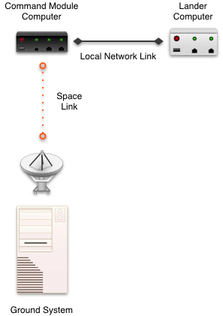
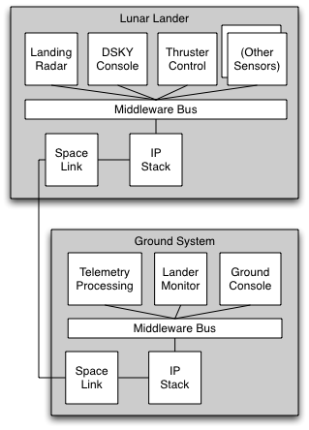
Example of View Inconsistency
Software Architecture: Foundations, Theory, and Practice; Richard N. Taylor, Nenad Medvidovic, and Eric M. Dashofy; © 2010 John Wiley & Sons, Inc. Reprinted with permission.

Slide 13
Common Types of Inconsistencies
Direct inconsistencies
E.g., “The system runs on two hosts” and “the system runs on three hosts.”
Refinement inconsistencies
High-level (more abstract) and low-level (more concrete) views of the same parts of a system conflict
Static vs. dynamic aspect inconsistencies
Dynamic aspects (e.g., behavioral specifications) conflict with static aspects (e.g., topologies)

Slide 14
Common Types of Inconsistencies (cont’d)
Dynamicity vs. dynamic aspect inconsistencies
Different descriptions of dynamic aspects of a system conflict
Functional vs. non-functional inconsistencies

Slide 15
Evaluating Modeling Approaches
Scope and purpose
What does the technique help you model? What does it not help you model?
Basic elements
What are the basic elements (the ‘atoms’) that are modeled? How are they modeled?
Style
To what extent does the approach help you model elements of the underlying architectural style? Is the technique bound to one particular style or family of styles?

Slide 16
Evaluating Modeling Approaches (cont’d)
Static and dynamic aspects
What static and dynamic aspects of an architecture does the approach help you model?
Dynamic modeling
To what extent does the approach support models that change as the system executes?
Non-functional aspects
To what extent does the approach support (explicit) modeling of non-functional aspects of architecture?

Slide 17
Evaluating Modeling Approaches (cont’d)
Ambiguity
How does the approach help you to avoid (or embrace) ambiguity?
Accuracy
How does the approach help you to assess the correctness of models?
Precision
At what level of detail can various aspects of the architecture be modeled?

Slide 18
Evaluating Modeling Approaches (cont’d)
Viewpoints
Which viewpoints are supported by the approach?
Viewpoint Consistency
How does the approach help you assess or maintain consistency among different views?

Slide 19
Kruchten’s 4+1 view model

Slide 20
4 + 1: Logical Viewpoint
The logical viewpoint supports the functional requirements, i.e., the services the system should provide to its end users.
Typically, it shows the key abstractions (e.g., classes and interactions amongst them).
Notes:
The logical view primarily supports the functional requirements; the services the system should provide to its end users.It depicts the major design elements and their interaction.
Designers decompose the system into a set of key abstractions, taken mainly from the problem domain. These abstractions are objects or object classes that exploit the principles of abstraction, encapsulation, and inheritance. In addition to aiding functional analysis, decomposition identifies mechanisms and design elements that are common across the system.
Components are related by “shares data with”
In termen van het boek is dit een module view

Slide 21
4 + 1: Process Viewpoint
Addresses concurrent aspects at runtime (tasks, threads, processes and their interactions)
It takes into account some nonfunctional requirements, such as performance, system availability, concurrency and distribution, system integrity, and fault-tolerance.
Notes:
The process view takes into account some nonfunctional requirements, such as performance and system availability. It addresses concurrency and distribution, system integrity, and fault-tolerance. The process view also specifies which thread of control executes each operation of each class identified in the logical view.
So the process view describes the mapping of functions to runtime elements. It concenrs the dynamics of the system. A process is a group of tasks which form a logical unit. A process can be started, stopped, resumed, etc., and there is communication between processes.
Components are related by “synchronizes with”
In termen van het boek: een C&C view

Slide 22
4 + 1: Deployment Viewpoint
The deployment viewpoint defines how the various elements identified in the logical, process, and implementation viewpoints-networks, processes, tasks, and objects-must be mapped onto the various nodes.
It takes into account the system's nonfunctional requirements such as system availability, reliability (fault-tolerance), performance (throughput), and scalability.
Notes:
The physical view takes into account the system's nonfunctional requirements such as system availability, reliability (fault-tolerance), performance (throughput), and scalability. The software executes on a network of computers (the processing nodes). The various elements identified in the logical, process, and development views-networks, processes, tasks, and objects-must be mapped onto the various nodes. Several different physical configurations will be used-some for development and testing, others for system deployment at various sites or for different customers. The mapping of the software to the nodes must therefore be highly flexible and have a minimal impact on the source code itself.
Components are related by “communicates with”
In termen van het boek: een allocation view

Slide 23
4 + 1: Implementation Viewpoint
The imlementation viewpoint focuses on the organization of the actual software modules in the software-development environment.
The software is packaged in small chunks-program libraries or subsystems-that can be developed by one or more developers.
Notes:
The development view focuses on the organization of the actual software modules in the software-development environment. The software is packaged in small chunks-program libraries or subsystems-that can be developed by one or more developers. The subsystems are organized in a hierarchy of layers, each layer providing a narrow and well-defined interface to the layers above it.
Components are related by “is submodule of”.
In termen van het boek: een allocation view

Slide 24
4 + 1: Scenario Viewpoint
The scenario viewpoint consists of a small subset of important scenarios (e.g., use cases) to show that the elements of the four viewpoints work together seamlessly.
This viewpoint is redundant with the other ones (hence the "+1"), but it plays two critical roles:
it acts as a driver to help designers discover architectural elements during the architecture design;
it validates and illustrates the architecture design, both on paper and as the starting point for the tests of an architectural prototype.
Notes:
The scenario view consists of a small subset of important scenarios-instances of use cases-to show that the elements of the four views work together seamlessly. For each scenario, we describe the corresponding scripts (sequences of interactions between objects and between processes). This view is redundant with the other ones (hence the "+1"), but it plays two critical roles:
it acts as a driver to help designers discover architectural elements during the architecture design;
it validates and illustrates the architecture design, both on paper and as the starting point for the tests of an architectural prototype.
The scenario view is important for stakeholder communication.

Slide 25
Architectural views from Bass et al (view = representation of a structure)
Module views
Module is unit of implementation
Decomposition, uses, layered, class
Component and connector (C & C) views
These are runtime elements
Process (communication), concurrency, shared data (repository), client-server
Allocation views
Relationship between software elements and environment
Work assignment, deployment, implementation
Notes:
Module structure: static, aimed at the implementation
Open question: what is the relation between structures?
The structure refers to the system itself, the corresponding view is how it is documented.

Slide 26
Module views
Decomposition: units are related by “is a submodule of”, larger modules are composed of smaller ones
Uses: relation is “uses” (calls, passes information to, etc). Important for modifiability
Layered is special case of uses, layer n can only use modules from layers <n
Class: generalization, relation “inherits from”
Notes:
Decomposition: vaak sartpunt voor design, nuttig vor modifiability (likely changes fall within a few modules), basis for project organization, structure of documentation, testplans, etc.
Uses: kun je gebruiken om functional subsets te bepalen. Maakt het dus mogelijk incrementele ontwikkeling te realiseren.
Layered: vaak “taal”, virtual machine.
Class: dan kun je redeneren over reuse, incremental addition of functionality.

Slide 27
Component and connector views
Process: units are processes, connected by communication or synchronization
Concurrency: to determine opportunities for parallelism (connector = logical thread)
Shared data: shows how data is produced and consumed
Client-server: cooperating clients and servers
Notes:
Process: relation is “attachment”, how are cmponents hooked together. Belangrijk voor performance, availability.
Concurrency: logical thread: sequence of computation that can be allocated to a separate physical thread later in the design rpocess. Used to determine possibilities for concurrency.
Shared data: gaatibution, load balancing (runtime performamce) over componenten die persistent data maken, opslaan, gebruiken. Handig als systeem dat voral doet. Goed voor performace, data integrity.
Client-server: connectors are the protocols and messages they exchange. Goed voor separation of concerns (modifiabilty), physical distribution

Slide 28
Allocation views
Deployment: how software is assigned to hardware elements
Implementation: how software is mapped onto file structures
Work assignment: who is doing what
Notes:
Deployment: elements: software (meestal process van C&C view), hardware elements and communication pathways. Geeft aan waar software zit, en hoe het evt migreert. Dan kun je redeneren over performance, security, availability, ed.
Implementation: voor management van ontwikkelactiviteiten, build processes.
Work assignment: welke kennis heb je waar nodig?, functional commonality aan 1 team toewijzen, etc.

Slide 29
How to decide on which viewpoints
What are the stakeholders and their concerns?
Which viewpoints address these concerns?
Prioritize and possibly combine viewpoints
Notes:
Bv via het maken van een stakeholder/view list. Geef aan hoeveel uit elke vew de stakeholders nodig hebben.
Vaak zul je views willen combineren, want je wilt er geen 12 maken. (bv module decomposition and implementation view kun je vaak combineren. Of module decomposition en layered of uses).

Slide 30
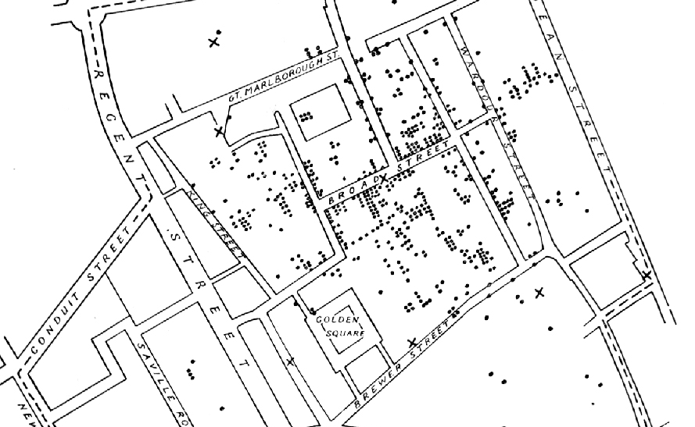
Decision visualization
Notes:
Londense arts, Snow. Platje komt uit Wikipedia

Slide 31
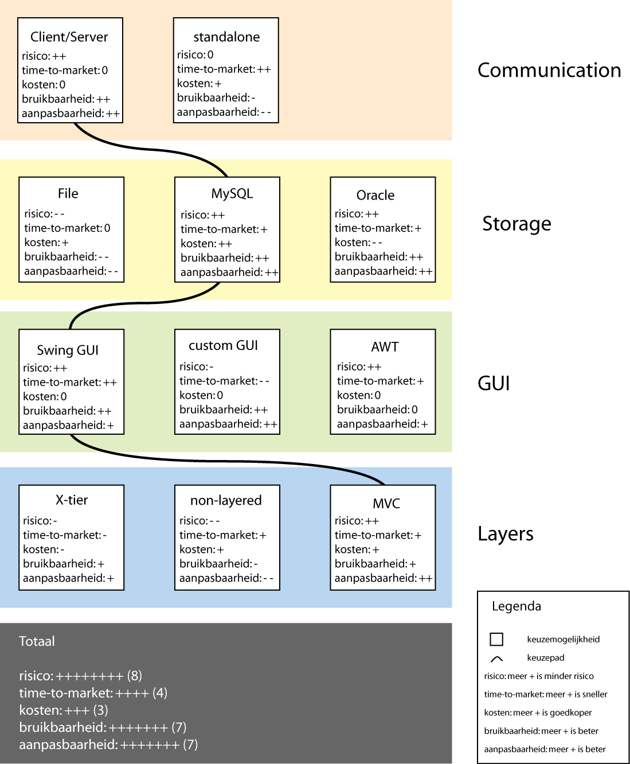
Business viewpoint

Slide 32
A caveat on quality
A view can be used to assess one or more quality attributes
E.g., some type of module view can be used to assess modifiability
It should then expose the design decisions that affect this quality attribute
Notes:
No single description (view) captures an architecture completely
Note that these views concern the system itself (the micro-architecture), and not the system in its environment (the macro architecture).
The 4+1 views are from the 1995 IEEE Software article. A similar set of views is given in Soni et al, 1995, ICSE proceedings.

Slide 33
Yet Another Set of Views/Viewpoints: DoD Architecture Framework DoDAF
Systems
Technical
Operational

Slide 34
DoD Architecture Framework 1.0
The Department of Defense (DoD) Architecture Framework (DODAF)
Defines a common approach for describing, presenting, and comparing DoD enterprise architectures
Facilitates the use of common principles, assumptions and terminology
The principal objective is to
Ensure that architecture descriptions can be compared and related across organizational boundaries, including Joint and multi-national boundaries

Slide 35
DoD Policy
Recent DoD policy highlights use of architectures for:
Understanding the DoD as an enterprise
Identification of operational requirements
Rationalization of IT investment decisions
Improvements to interoperability among various systems

Slide 36
Architecture Definition
“The structure of components, their relationships, and the principles and guidelines governing their design and evolution over time.” DoD Integrated Architecture Panel, 1995, based on IEEE STD 610.12
“An architecture is the fundamental organization of a system embodied in its components, their relationships to each other, and to the environment, and the principles guiding its design and evolution.” IEEE STD 1471-2000

Slide 37
Architecture vs. Design
System Architecture is used to:
Make buy decisions
Discriminate between options
“Discover” the true requirements
Drive one or more systems to a common “use” or purpose
System Design is used to:
Develop system components
Build the system
Understand configuration changes as the system is modified

Slide 38
Enterprise vs. System
System Architecture is like blueprints for a building
Enterprise Architecture is like urban planning

Slide 39
Architecture Framework
“An architecture framework is a tool… It should describe a method for designing an information system in terms of a set of building blocks, and for showing how the building blocks fit together. It should contain a set of tools and provide a common vocabulary. It should also include a list of recommended standards and compliant products that can be used to implement the building blocks.” [TOGAF 8, OpenGroup]
Notes:
TOGAF, The Open Group Architecture Framework, is an industry standard architecture framework that may be used freely by any organization wishing to develop an information systems architecture for use within that organization
The Open Group is an international vendor and technology-neutral consortium
The mission of The Open Group is to drive the creation of Boundaryless Information Flow achieved by:
Working with customers to capture, understand and address current and emerging requirements, establish policies, and share best practices;
Working with suppliers, consortia and standards bodies to develop consensus and facilitate interoperability, to evolve and integrate specifications and open source technologies;
Offering a comprehensive set of services to enhance the operational efficiency of consortia; and
Developing and operating the industry's premier certification service and encouraging procurement of certified products

Slide 40
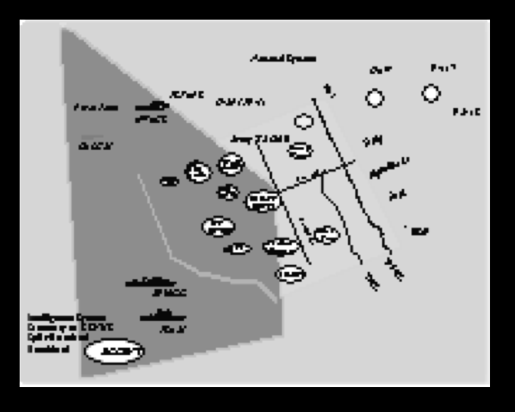
Basic Principles - An Integrated Architecting Method with Three Views
Activities/
Tasks
Operational
Elements
Operational
View
Identifies What Needs To Be Done And Who Does It
Information Flow
Systems
Data Flow
Standards
Rules
Systems
View
Technical
Standards View
X
Relates Systems and Characteristics to Operational Needs
X
Z
Y
Y
Prescribes Standards
Conventions
Y
X
Communications
Conventions

Slide 41
DODAF Products - Graphic, Textual, and Tabular
Graphic
Text
Tabular
Dictionary Relationships
Organizations
Locations
Functions
Applications
Entities
Database/file
Tech Platform
Operational
Node Name
Needline Name
Operational
Activity
Link
Name/ID
Organizations
Locations
Functions
Applications
Entities
Database/file
Technology Platforms
Systems
Node Name
System
Name
System
Component
Name
X
X
X
X
X
X
X
System
Function
Name
Component
Interface
Name
X
X
X
X
Use products to:
Capture
Communicate
Analyze

Slide 42
DODAF Products
The DODAF describes a set of 26 work products to ensure uniformity and standardization in the documentation and communication of architecture
The 26 DODAF views are designed to document the entire architecture, from requirements to implementation

Slide 43
DODAF Products - Views
The list of products is refined into four views:
All Views (AV): is the overarching information describing the architecture plans, scope, and definitions
Operational View (OV): focuses on the behaviours and functions describing the enterprise mission aspects
System View (SV): describes the system and applications supporting the mission functions
Technical Standards View (TV): describes the policies, standards and constraints

Slide 44



10 min break?

Slide 45
Software Architecture & Quality
The notion of quality is central in software architecting: a software architecture is devised to gain insight in the qualities of a system at the earliest possible stage.
Some qualities are observable via execution: performance, security, availability, functionality, usability
And some are not observable via execution: modifiability, portability, reusability, integrability, testability

Slide 46
Analysis of architectures
A number of QoS dimensions of the resulting system are directly influenced by the architectural style of choice
Scalability
Reliability
Availability
Usability
…
Specific methodologies to analyze these aspects exist
Notes:
46

Slide 47
Analysis techniques
There are two broad classes of techniques to evaluate a software architecture:
The first class comprises measuring techniques, and rely on quantitative information. Examples include architecture metrics and simulation. (Availability and Reliability)
The second class comprises questioning techniques, in which one investigates how the architecture reacts to certain situations. This is often done with the help of scenarios (ATAM method, see before)

Slide 48

Availability
A service shall be continuously available to the user
Little downtime and rapid service recovery
The availability of a service depends on:
Complexity of the IT infrastructure architecture
Reliability of the individual components
Ability to respond quickly and effectively to faults
Quality of the maintenance by support organizations and suppliers
Quality and scope of the operational management processes

Slide 49

Reliability
Adequate reliability means that the service is available for an agreed period without interruptions
The reliability of a service increases if downtime can be prevented
Reliability is determined by:
Reliability of the components used to provide the service
Ability of a service or component to operate effectively despite failure of one or more subsystems
Preventive maintenance to prevent downtime

Slide 50
System life-cycle
response
time
repair
time
recovery
time
detection
time
Incident
Time of occurrence: Time at which the user becomes aware of the fault
Detection time: The service provider is informed of the fault
Response time: Time required by the service provider (diagnosis) to respond to the user
Repair time: Time required to restore the service or the components that caused the fault
Recovery time: Time required to restore the system (re-configuration, re-initialization,…)

Slide 51
System life-cycle
Time Between Failure
Downtime, Time to repair
Uptime, Time to failures
response
time
repair
time
recovery
time
detection
time
Incident
Resolution
time
Incident
Recovery
Mean Time to Repair (MTTR): Average time between the occurrence of a fault and service recovery, also known as the downtime
Mean Time To Failures (MTTF): Mean time between the recovery from one incident and the occurrence of the next incident, also known as uptime
Mean Time Between failure (MTBF): Mean time between the occurrences of two consecutive incidents

Slide 52
Availability vs. Reliablity
Availability: The probability that a component is working properly at time t
A = MTTF / (MTTF+MTTR)
Reliability: The probability that a component has always been working properly during a time interval (0,t)
R = e^{-λt} λ = 1/MTTF
Reliability requires that the component never fails in the interval (0,t)
From the availability perspective a given component could have failed in the interval (0,t), but it could have been repaired before t

Slide 53
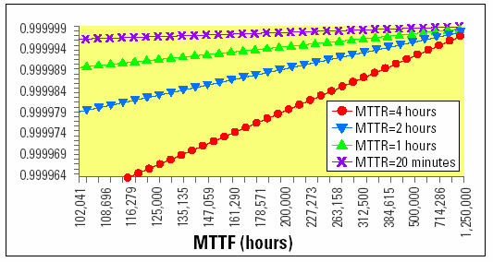
Availability, MTTF, MTTR
MTBF = MTTF+MTTR (if MTTR small, MTBF ≅ MTTF)

Slide 54
Nines notation
Availability is typically specified in nines notation
For example 3-nines availability corresponds to 99.9%, 5-nines availability corresponds to 99.999% availability
Availability | Downtime
90% (1-nine) | 36.5 days/year
99% (2-nines) | 3.65 days/year
99.9% (3-nines) | 8.76 hours/year
99.99% (4-nines) | 52 minutes/year
99.999% (5-nines) | 5 minutes/year

Slide 55
Availability
Calculated by modeling the system as an interconnection of parts in series and parallel
If failure of a part leads to the combination becoming inoperable, the two parts are considered to be operating in series
If failure of a part leads to the other part taking over the operations of the failed part, the two parts are considered to be operating in parallel

Slide 56
Availability in series
The combined system is operational only if both every part is available
The combined availability is the product of the availability of the component parts
A₁
A₂
…
A_{n}

Slide 57

Availability in series – A numerical example
 | Availability | Downtime
Component 1 | 99% (2-nines) | 3.65 days/year
Component 2 | 99.999% (5-nines) | 5 minutes/year
Combined
98.999%
~3.65 days/year
Downtime=(1-A)*365 days/year
The availability of the entire system is negatively affected by the low availability of Component 1
A chain is as strong as the weakest link!
Notes:
A = 98.9990100% -> 99% -> 3.65 days/year

Slide 58
Availability in parallel
The combined system is operational if at least one part is available
The combined availability is 1 - (all parts are unavailable)
A₁
A₂
.
.
.
A_{n}

Slide 59
Availability in parallel – A numerical example
 | Availability | Downtime
Component 1 | 99% (2-nines) | 3.65 days/year
Component 2 | 99% (2-nines) | 3.65 days/year
Combined
99.99% (4-nines)
52 minutes/year
Downtime=(1-A)*365 days/year
Even though very low availability components are used, the overall availability of the system is much higher
Mission critical systems are designed with redundant components!
Notes:
99.99%
52 minutes/year

Slide 60
Availability of complex systems
A₇=1-(1-A₁)(1-A₂)
A₁
A₃
A₂
A₅
A₆

Slide 61
Availability of complex systems
A₈=A₇A₃
A₇
A₃
A₅
A₆

Slide 62
Availability of complex systems
A₉
A₁₀=A₅A₆
A₅
A₆

Slide 63
Availability of complex systems
A=1-(1-A₉)(1-A₁₀)
A₉
A₁₀

Slide 64
In Summary, so far…
Describing the architecture of a software system means
Identifying the high-level organizational structure most suitable to our design space (previous lect.)
Identify the views that are most relevant for representation
Standardize view representations and content to harmonize SA description
Assess the qualities of the architecture
Record all design decisions and the process that you followed to get to them

Slide 65
Last but not least...
Describing Architectures with UML!
Only hints, useful in industry

Slide 66
Architecture and Iterations
Use case Model
Design Model
Implementation Model
Deployment Model
Test Model
Architectural Content

Slide 67
UML Models, Views, and Diagrams
State
Diagrams
State
Diagrams
Class
Diagrams
Use Case
Diagrams
Use Case
Diagrams
State
Diagrams
Use Case
Diagrams
Use Case
Diagrams
State
Diagrams
Use Case
Diagrams
Object
Diagrams
Sequence
Diagrams
Scenario
Diagrams
State
Diagrams
Scenario
Diagrams
State
Diagrams
Collaboration
Diagrams
Component
Diagrams
Models
Scenario
Diagrams
Component
Diagrams
Scenario
Diagrams
Component
Diagrams
Statechart
Diagrams
Deployment
Diagrams
Activity
Diagrams

Slide 68
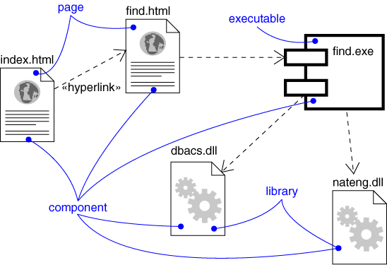
Component Diagram
Captures physical structure of system implementation

Slide 69
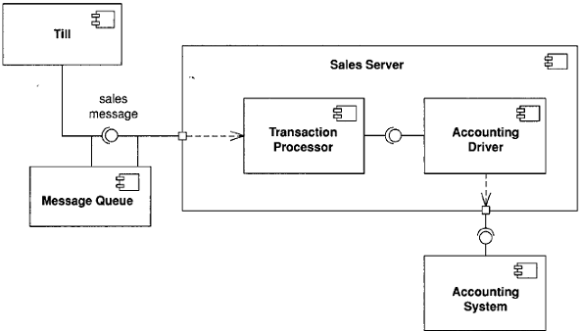
Component Diagram
Captures physical structure of system implementation

Slide 70
Component Diagram
Captures the physical structure of the implementation
Built as part of architectural specification
Purpose
Organize source code
Construct an executable release
Specify a physical database
Developed by architects and programmers

Slide 71
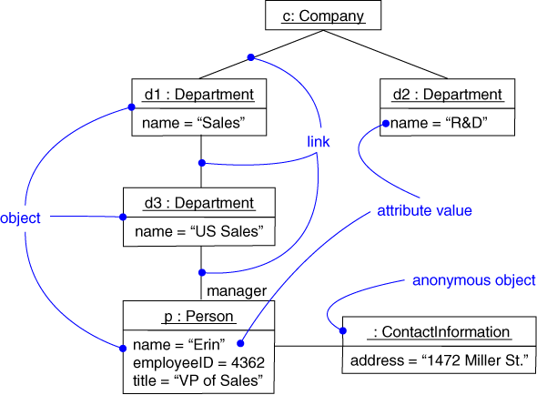
Object Diagram
Captures instances and links

Slide 72
Object Diagram
Shows instances and links that architecture elements maintain across functions
Built during analysis and design
Purpose
Illustrate data/object structures
Specify architecture runtime snapshots
Developed by analysts, designers, and implementers

Slide 73
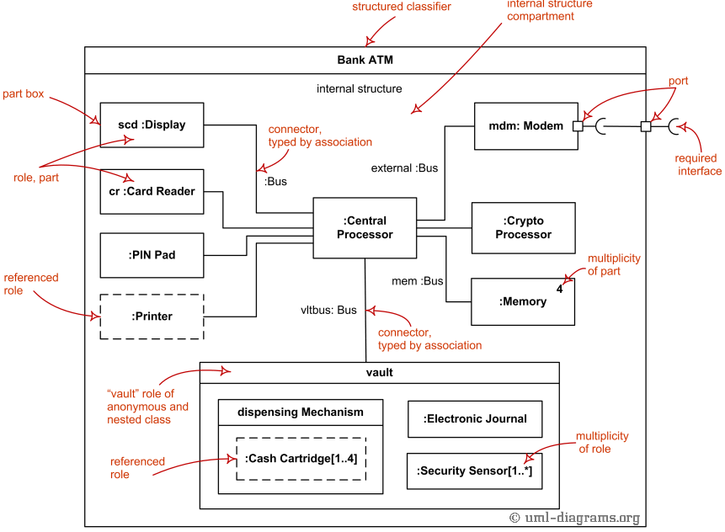
Composite Structure Diagram
Captures the internal modular structure of components

Slide 74
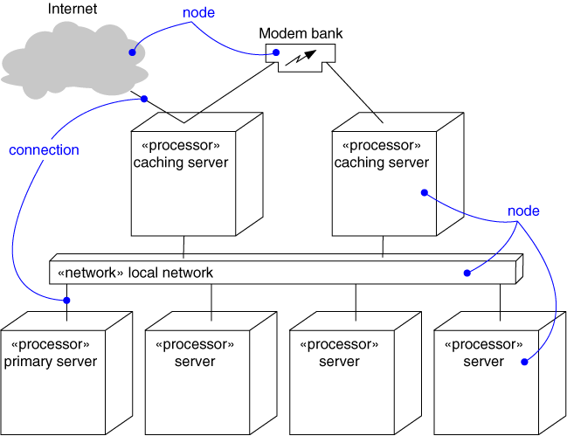
Deployment Diagram
Captures the topology of a system’s hardware

Slide 75
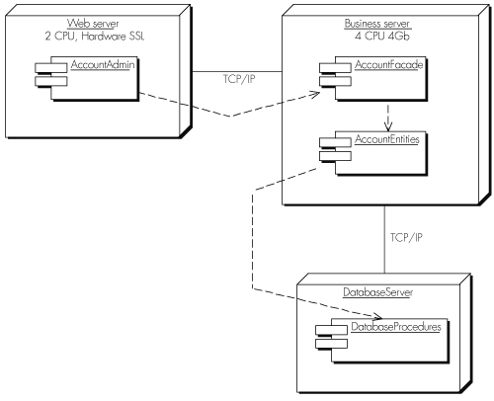
Deployment Diagram
Captures the topology of a system’s hardware… but not only!

Slide 76
Deployment Diagram
Captures the topology of a system’s hardware
Built as part of architectural specification
Purpose
Specify the distribution of components
Identify performance bottlenecks
Developed by architects, networking engineers, and system engineers

Slide 77
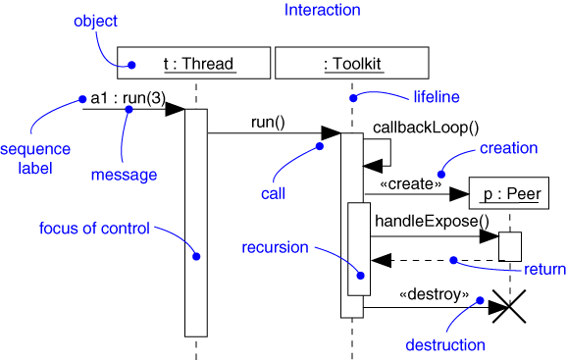
“Architectural” Sequence Diagram
Captures dynamic module and/or component behavior (time-oriented)

Slide 78
“Architectural” Sequence Diagram
Captures dynamic behavior (time-oriented)
Purpose
Model flow of control
Illustrate typical scenarios
Analyse architecture -ilities

Slide 79
Putting it all at work… a sample scenario from a Student Project!

Slide 80
Let’s see... Solution description!
“We will implement a client-server architecture (Fig. 2) based on common REST API and MVC pattern, so with just one server application we manage both web application and mobile application, obviously we will have a version for taxi driver and a version for clients covering cases for handling login and other requests from drivers and clients.”
Cit. [the student’s interpretation of the textual specification]

Slide 81
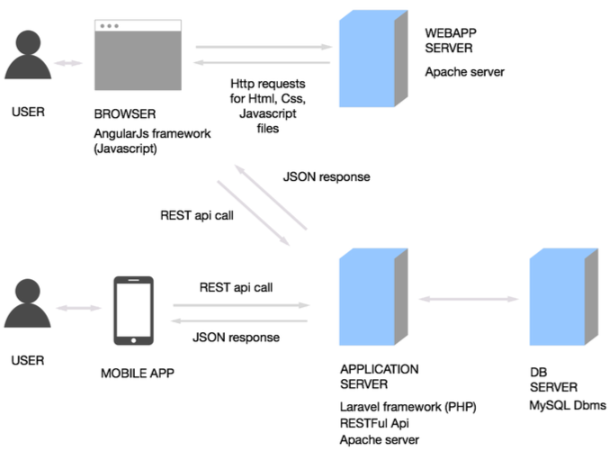
Meanwhile, back in the requirements... Architecture Draft?!

Slide 82
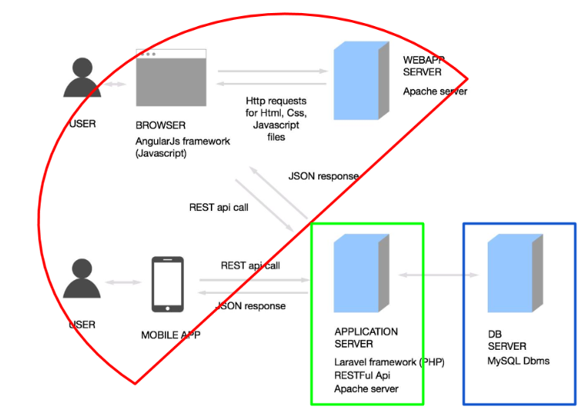
and... First Architecture Decision!
* Architecture is a set of Design Decisions... Decision 1, three tiers!

Slide 83
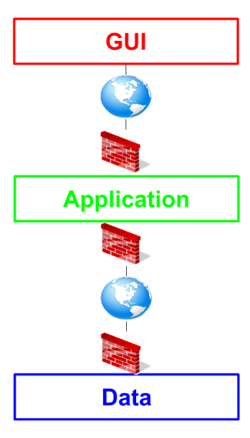
Architecture With Style
Hint: Document your decisions
And their reasons...
e.g., here you may want a secure distributed system

Slide 84
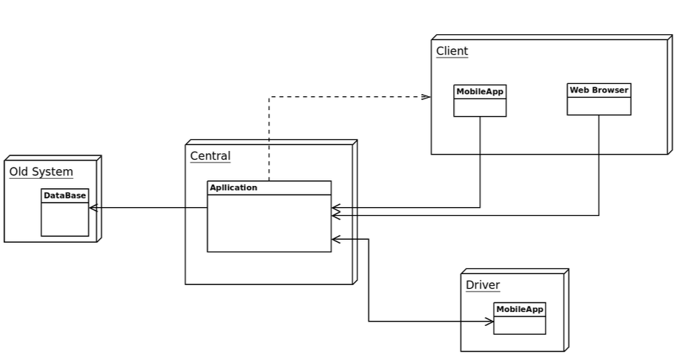
High-Level Components
You need to map your decisions to high-level physical representations

Slide 85
High-Level Components
You need to map your decisions to high-level physical representations... And don’t forget the requirements!
R x.y: “the system must integrate
With a previously existing solution”

Slide 86
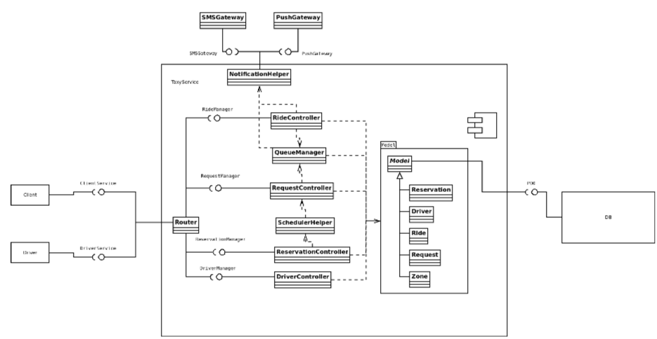
A composite structure to elaborate modules...
This would be a good point to elaborate requirements traceability

Slide 87
A composite structure to elaborate modules...
Remember:
Consistent naming

Slide 88
A composite structure to elaborate modules...
Remember:
Consistent naming
UML relations reflect runtime properties!

Slide 89
A composite structure to elaborate modules...
Remember:
Consistent naming
UML relations reflect runtime properties!
There is an architecture reason to elaborate but there is also a reason when you don’t!

Slide 90
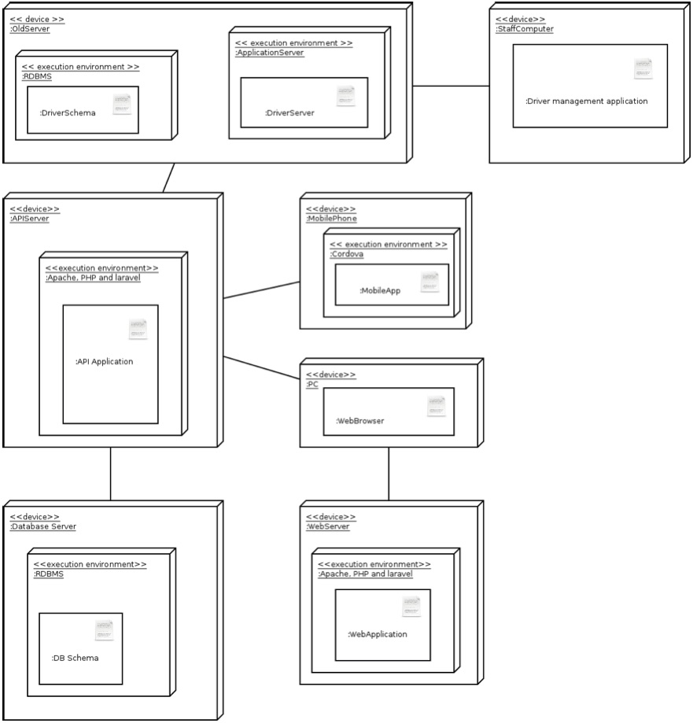
A deployment diagram to elaborate physical components allocation
remember:
Deployment needs to reflect style restrictions
Tier 1?
Tier 2?
Tier 3?

Slide 91
A deployment diagram to elaborate physical components allocation
remember:
Deployment needs to reflect style restrictions
Deployment links need to follow composite structure
Tier 1?
Tier 2?
Tier 3?

Slide 92
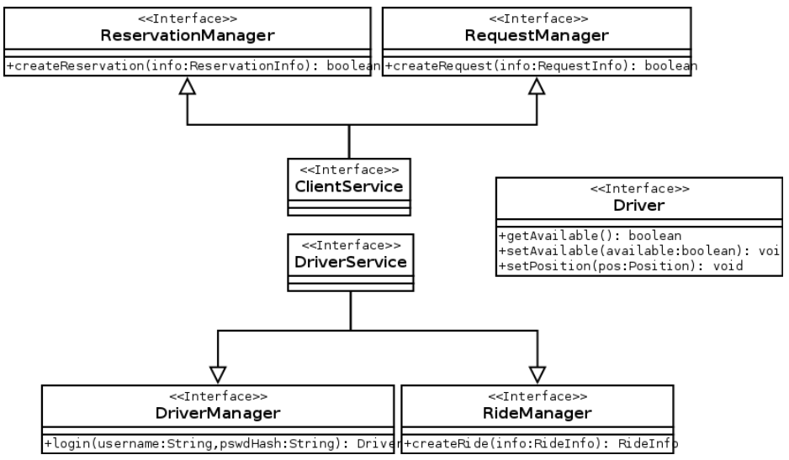
But... I also have a class diagram!
Try to provide at least the same level of detail for each view...

Slide 93
Process View... Activities & States!
<Omitted for the sake of brevity*>
Remember to provide behavioral architecture views that:
Convey meaningful architecture properties (find them in the requirements), e.g., for analysis;
Reflect implementable behavior (functional);
Make behavioral assumptions explicit (requirements and domain assumptions!);

Slide 94
So, in practice...
Iteration between architecture (and architecture views/diagrams) and requirements is key!
Software Architecture Views (e.g., diagrams + design decisions...)
Requirements Specification (e.g., diagrams + text + Alloy...)

Slide 95

Thanks for your endurance…
Shall we go home?
Coming up next… Full example of architecting + Formal design descriptions!

Slide 96
Foundations of Complex Software Architectures and Styles
Damian A. Tamburri, Ph.D.
damianandrew.tamburri@polimi.it
dtamburri@acm.org

Slide 97
Yet another example... Let’s Design an Artificial Neural Network*!

Slide 98
Usual drill... Some text!
“An ANN is a structure consisting of interconnected nodes that communicate with one another. The structure and its functionality are inspired by neural networks found in a biological brain. Hebbian Theory explains [...] Similarly, a typical ANN has connections between nodes that have a weight which is updated as the network learns. The nodes labeled "+1" are called biases. The leftmost blue column of nodes are input nodes, the middle column contains hidden nodes, and the rightmost column contains output nodes. There may be many columns of hidden nodes, known as hidden layers...”
Goal: devise a system to support ANNs:
→ draw a single digit;
→ OCR training with digit;
→ request the system for a prediction;
Notes:
Hebbian theory is a theory in neuroscience that proposes an explanation for the adaptation of neurons in the brain during the learning process, describing a basic mechanism for synaptic plasticity, where an increase in synaptic efficacy arises from the presynaptic cell's repeated and persistent stimulation of the postsynaptic cell. Introduced by Donald Hebb in his 1949 book The Organization of Behavior

Slide 99
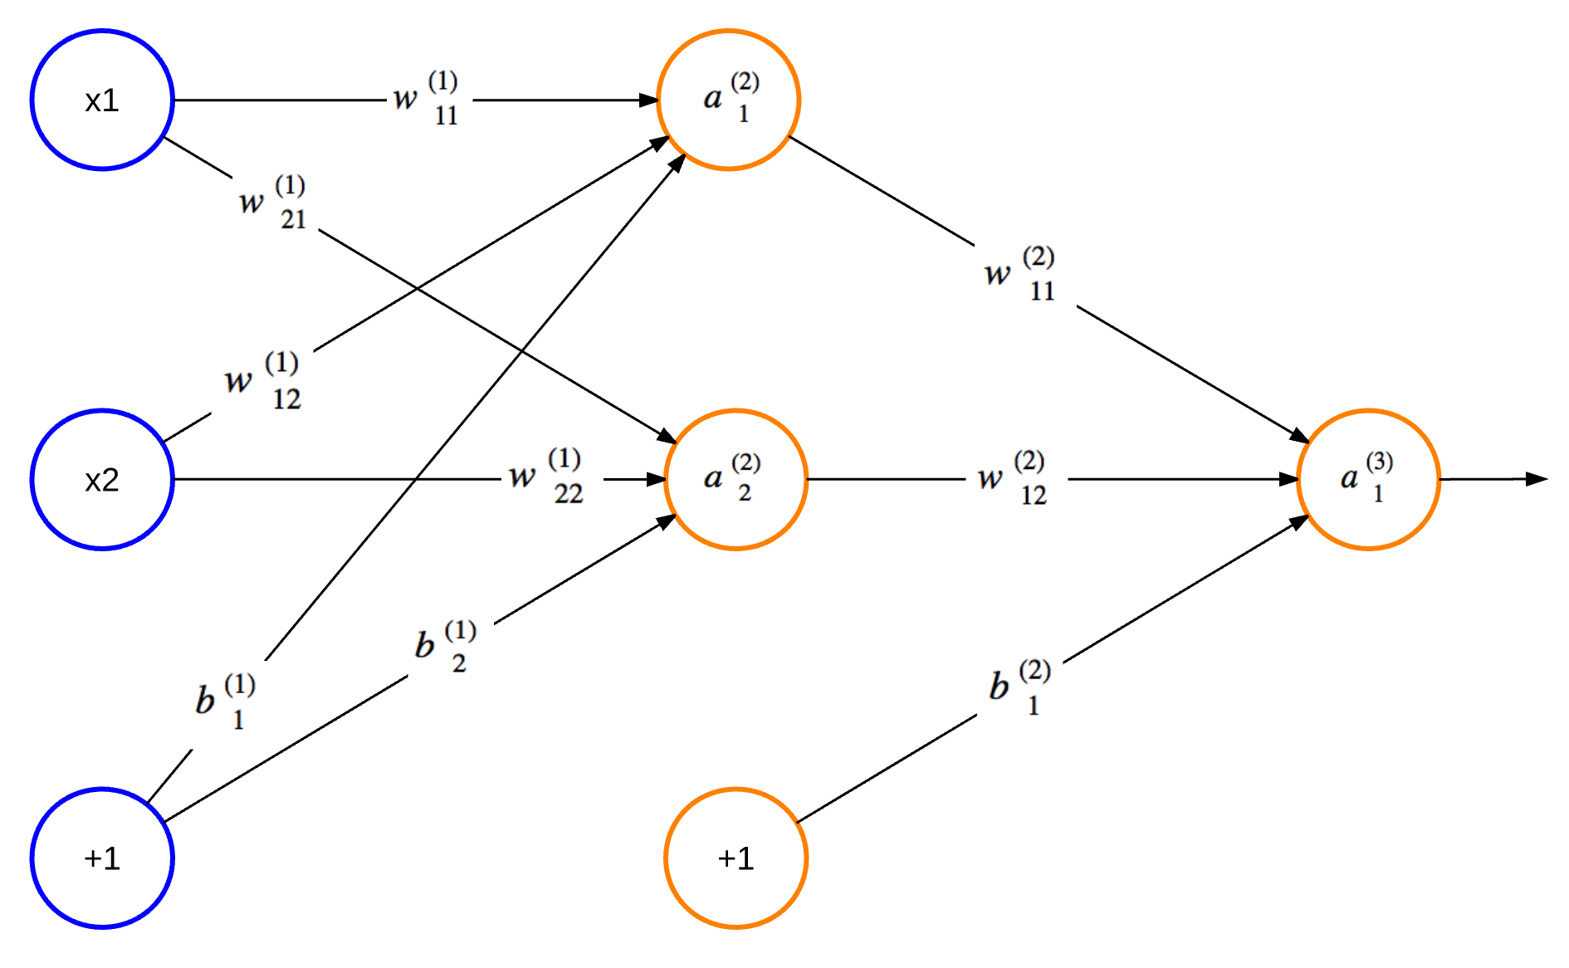
ANN, let’s visualize an example
nodes
labels
edges

Slide 100
Now... Let’s focus on the top-most goal(s)
“An ANN is a structure consisting of interconnected nodes that communicate with one another. The structure and its functionality are inspired by neural networks found in a biological brain. Hebbian Theory explains [...] Similarly, a typical ANN has connections between nodes that have a weight which is updated as the network learns. The nodes labeled "+1" are called biases. The leftmost blue column of nodes are input nodes, the middle column contains hidden nodes, and the rightmost column contains output nodes. There may be many columns of hidden nodes, known as hidden layers...”
Goal: devise a system to support ANNs:
→ draw a single digit;
→ OCR training with digit;
→ request the system for a prediction;

Slide 101
Now... Let’s focus on the top-most goal(s)
So... We need:
ANN system;
An interface with that system;
ANN Design logic;
ANN Training logic;
Goal: devise a system to support ANNs:
→ draw a single digit;
→ OCR training with digit;
→ request the system for a prediction;

Slide 102
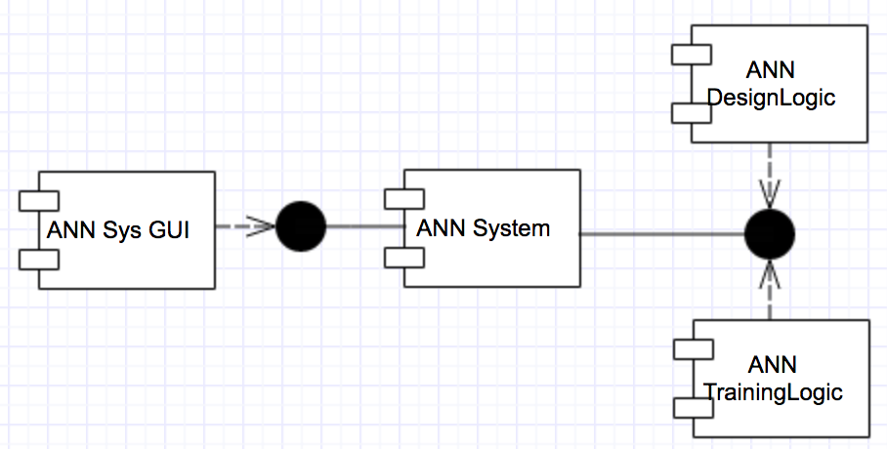
Now... Let’s focus on the top-most goal(s)
So... We need:
ANN system;
ANN interface;
ANN Design logic;
ANN Training logic;
Sys Main

Slide 103
Now... Let’s focus on the top-most goal(s)
So... We need:
ANN system;
ANN interface;
ANN Design logic;
ANN Training logic;
Sys Main

Slide 104
Now... Let’s focus on the top-most goal(s)
So... We need:
ANN system;
ANN interface;
ANN Design logic;
ANN Training logic;
Sys Main

Slide 105
Now... Let’s focus on the top-most goal(s)
So... We need:
ANN system;
ANN interface;
ANN Design logic;
ANN Training logic;
Sys Main
...Enough?

Slide 106
Now... Let’s focus on the top-most goal(s)
So... We need:
ANN system;
ANN interface;
ANN Design logic;
ANN Training logic;
Sys Main
Is this good?
Goal: devise a system to support ANNs:
→ draw a single digit;
→ OCR training with digit;
→ request the system for a prediction;

Slide 107
Now... Let’s focus on the top-most goal(s)
So... We need:
ANN system;
ANN interface;
ANN Design logic;
ANN Training logic;
Sys Main
Is this good? Depends...
Does it follow design principles?
Does it match known styles?
...
Goal: devise a system to support ANNs:
→ draw a single digit;
→ OCR training with digit;
→ request the system for a prediction;

Slide 108
Always remember...
Theorem: “Software Architects Solve Problems”
Proof - <internet still exists>
Corollary – <software is a problem>

Slide 109
Now... Let’s focus on the top-most goal(s)
So... We need:
ANN system;
ANN interface;
ANN Design logic;
ANN Training logic;
Sys Main
Is this good? Probably:
Loose coupling
Low cohesion
High modularity
consistent with Client/server
...
Decision 1: this architecture is good!

Slide 110
Now... Let’s focus on the top-most goal(s)
So... We need:
ANN system;
ANN interface;
ANN Design logic;
ANN Training logic;
Sys Main
Is this good? Probably.
Loose coupling
Low cohesion
High modularity
consistent with Client/server
...
Decision 1: this architecture is good!

Slide 111
Now... Let’s focus on the top-most goal(s)
So... We need:
ANN system;
ANN interface;
ANN Design logic;
ANN Training logic;
Sys Main
Is this good? Probably.
Loose coupling
Low cohesion
High modularity
consistent with Client/server
...
Decision 2: let’s use Client/Server!

Slide 112
Now... Let’s focus on the top-most goal(s)
Client!
So... We need:
ANN system;
ANN interface;
ANN Design logic;
ANN Training logic;
Sys Main
Is this good? Probably.
Loose coupling
Low cohesion
High modularity
consistent with Client/server
...
Decision 2: let’s use Client/Server!

Slide 113
Now... Let’s focus on the top-most goal(s)
Client!
Server?
So... We need:
ANN system;
ANN interface;
ANN Design logic;
ANN Training logic;
Sys Main
Is this good? Probably.
Loose coupling
Low cohesion
High modularity
consistent with Client/server
...
Decision 2: let’s use Client/Server!

Slide 114
Now... Let’s focus on the top-most goal(s)
Client!
Server(s)?
So... We need:
ANN system;
ANN interface;
ANN Design logic;
ANN Training logic;
S1
S2
Sys Main
Is this good? Probably.
Loose coupling
Low cohesion
High modularity
consistent with Client/server
...
Decision 2: let’s use Client/Server!

Slide 115
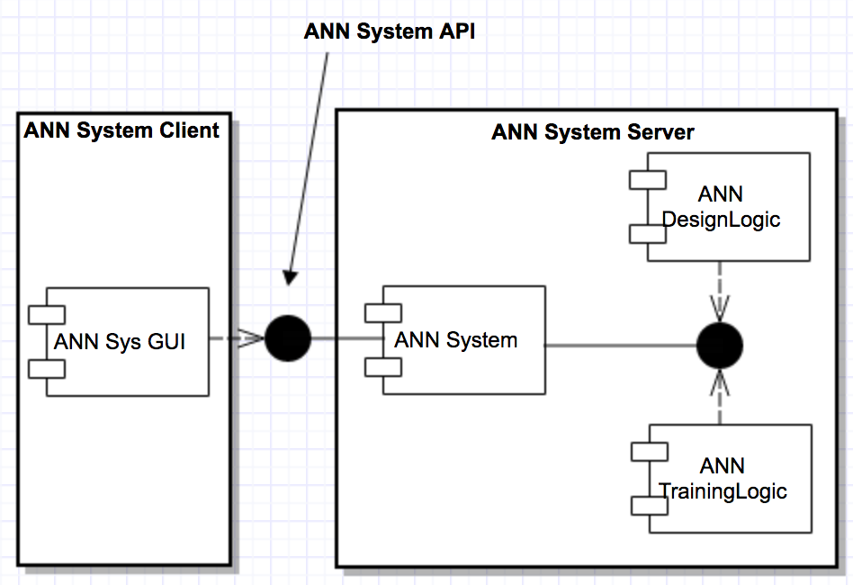
Now... Let’s focus on the top-most goal(s)
Decision 2: let’s use the simplest Client/Server!
Sys Main

Slide 116
Now... Let’s focus on the top-most goal(s)
Architecture issue on Decision 2: does this make sense?!
Sys Main

Slide 117
Now... Let’s focus on the top-most goal(s)
Decision 3: ...it does! Simple, cohesive, reflects sys. goals...
Sys Main

Slide 118
Now... Let’s focus on the top-most goal(s)
Architecture Implementation Issue:
→ how do I implement ANN System in Client/Server?
- I’m very good with Python so I’ll use that for logic;
- The Client/Server style comes with technology!
a. HTTP/REST for interfacing;
b. JavaScript for client logic;
...

Slide 119
Now... Let’s focus on the top-most goal(s)
Architecture Implementation Issue:
→ how do I implement ANN System in Client/Server?
- I’m very good with Python so I’ll use that for logic;
- The Client/Server style comes with technology!
a. HTTP/REST for interfacing;
b. JavaScript for client logic;
...
Decision 4: Let’s implement with HTTP for interfacing, Python for server logic and JS for client logic

Slide 120
All said and done
5 modules:
a client (e.g., ocr.js)
a server (e.g., server.py)
a simple user interface (e.g., ocr.html)
an ANN trained via backpropagation (e.g., ocr.py)
an ANN design script (e.g., neural_network_design.py)

Slide 121
All said and done
5 modules:
a client (e.g., ocr.js)
a server (e.g., server.py)
a simple user interface (e.g., ocr.html)
an ANN trained via backpropagation (e.g., ocr.py)
an ANN design script (e.g., neural_network_design.py)
Hint: always use meaningful names!

Slide 122
All said and done
5 modules:
a client (e.g., ocr.js)
a server (e.g., server.py)
a simple user interface (e.g., ocr.html)
an ANN trained via backpropagation (e.g., ocr.py)
an ANN design script (e.g., neural_network_design.py)
Hint: * Always * use coding standards!

Slide 123
OCR Interface
<html>
<head>
<script src="ocr.js"></script>
<link rel="stylesheet" type="text/css" href="ocr.css">
</head>
<body onload="ocrDemo.onLoadFunction()">
<div id="main-container" style="text-align: center;">
<h1>OCR Demo</h1>
<canvas id="canvas" width="200" height="200"></canvas>
<form name="input">
<p>Digit: <input id="digit" type="text"> </p>
<input type="button" value="Train" onclick="ocrDemo.train()">
<input type="button" value="Test" onclick="ocrDemo.test()">
<input type="button" value="Reset" onclick="ocrDemo.resetCanvas();"/>
</form>
</div>
</body>
</html>

Slide 124
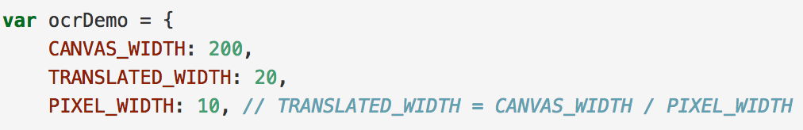
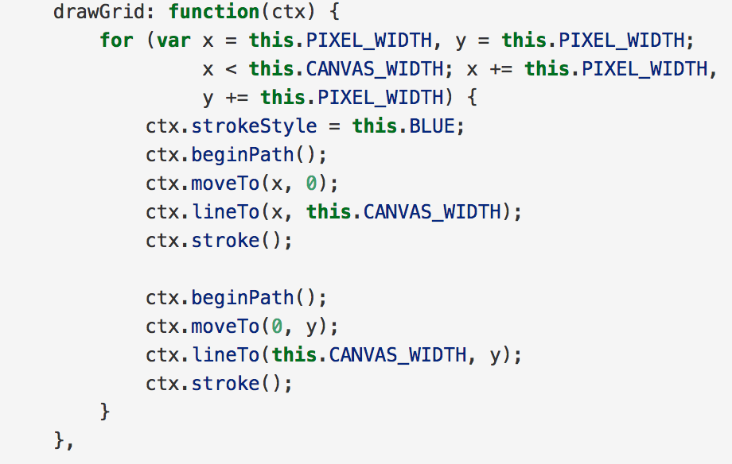
OCR Client
Init signature
Function: Draw a blue grid;
...

Slide 125
OCR Client
Coding Standard!
Using ESLint here

Slide 126
ANN Stakeholder: where are we?
Sys Main

Slide 127
Stakeholder: where are we?
Architect: we are here.
Sys Main

Slide 128
What’s next?
Iterate! Iterate! Iterate!

Slide 129
What’s next?
Iterate! Iterate! Iterate!
Until we’re done developing/integrating/testing...

Slide 130

Any Questions?

Slide 131
10 min break?

Slide 132
Architecture Description Languages
The positives
ADLs represent a formal way of representing architecture
ADLs are intended to be both human and machine readable
ADLs support describing a system at a higher level than previously possible
ADLs permit analysis of architectures – completeness, consistency, ambiguity, and performance
ADLs can support automatic generation of software systems
The negatives
There is not universal agreement on what ADLs should represent, particularly as regards the behavior of the architecture
Representations currently in use are relatively difficult to parse and are not supported by commercial tools
Most ADL work today has been undertaken with academic rather than commercial goals in mind
Most ADLs tend to be very vertically optimized toward a particular kind of analysis

Slide 133
Architecture vs. Design
Architecture: where non-functional decisions are cast, and functional requirements are partitioned
Design: where functional requirements are accomplished
architecture (ADL)
non-functional requirements (“ilities”)
design (UML)
functional requirements (domains)
Heuristic: it is necessary to go one level deeper to validate choices, so the architect has to do a high-level design to validate the partitioning

Slide 134
Quality Attributes and Architectural Strategies
Dependability
Interoperability
Usability
Performance
Adaptability
Cost
Schedule
Assurance monitoring & control
Layering
Diagnostics
Pipelining
Architecture balance
Parallelism
GUI-driven
API-driven
Performance monitoring & control
Change-source hiding
COTS/reuse-driven
Positive Effects
Negative Effects

Slide 135
Common Concept of Architecture: Object Connection Architecture
Configuration consists of the interfaces and connections of an object-oriented system
Interfaces specify the features that must be provided by modules conforming to an interface
Connections represented by interfaces together with call graph
Conformance usually enforced by the programming language
decomposition - associating interfaces with unique modules
Interface conformance - static checking of syntactic rules
communication integrity - visibility between modules

Slide 136
An Object Connection Architecture

Slide 137
Object Connection Architecture
The good news
Mature development languages - C++, Ada, Java
Visual modeling and automatic code generation tools
Standardized modeling language - UML
The bad news
Modules must be built before the architecture is defined
Architecture not invariant under changes to system
Conformance of a system to an architecture is minimal
Can not be used to plan a system
Really not an architecture at all!

Slide 138
Another Concept of Architecture: Interface Connection Architecture
Expands the role of interfaces and connections
Interfaces specify both “required” and “provided” features
Connections are defined between “required” features and “provided” features
Consists of interfaces, connections and constraints
Constraints restrict behavior of interfaces and connections in an architecture
Constraints in an architecture map to requirements for a system

Slide 139
An Interface Connection Architecture
provides
requires
connection
interface
module

Slide 140
Interface Connection Architecture
The Good news
Improved conformance of a system to an architecture
Architecture can be built before modules are implemented
The bad news
No emerging standard
Poor quality tools
Most ADLs implement an interface connection architecture.

Slide 141
Software Architecture: ADL Perspective
The ADL community generally agrees that Software Architecture is a set of components and the connections among them.
components
connectors
configurations
constraints

Slide 142
ADLs Considered by MCC
Leading candidates
ACME (CMU/USC)
Rapide (Stanford)
Wright (CMU)
Unicon (CMU)
Secondary candidates
Aesop (CMU)
MetaH (Honeywell)
C2 SADL (UCI)
SADL (SRI)
Others
Lileanna
UML
Modechart

Slide 143
ACME
ACME was developed jointly by Monroe, Garlan (CMU) and Wile (USC)
ACME is a general purpose ADL originally designed to be a lowest common denominator interchange language
ACME as a language is extremely simple (befitting its origin as an interchange language)
ACME has no native behavioral specification facility so only syntactic linguistic analysis is possible
there are currently efforts under consideration to define a behavioral semantics for ACME, possibly along the Wright/CSP line
ACME has no native generation capability
ACME has seen some native tool development, and there are indications of more, as well as use of other language tools via interchange

Slide 144
An ADL Example (in ACME)
System simple_cs = {
Component client = {Port send-request}
Component server = {Port receive-request}
Connector rpc = {Roles {caller, callee}}
Attachments : {client.send-request to rpc.caller;
server.receive-request to rpc.callee}
}
client
send-request
rpc
server
receive-request
caller
callee

Slide 145
Rapide
Rapide was developed by Dr. David Luckham at Stanford
Rapide is a general purpose ADL designed with an emphasis on simulation yielding partially ordered sets of events (posets)
Rapide as a language is fairly sophisticated, including data types and operations
Rapide analysis tools focus on posets
matching simulation results against patterns of allowed/prohibited behaviors
some support for timing analysis
focus on causality
Rapide has some generation capability since Rapide specifications are executable
Rapide has a fairly extensive toolset

Slide 146
The Rapide Model
Rapide is a concurrent, object-oriented , event-based simulation language
Defines and simulates behavior of distributed object system architectures
Produces a simulation represented by a set of events (poset)
Events are ordered with respect to time and causality
System requirements are expressed as constraints on time and concurrent patterns of events
Posets enable visualization and analysis of an execution

Slide 147
The Rapide Model (cont’d)
Components execute independently
Components both observe and generate events
Each event represents the occurrence of an activity
Generates dependent events
Reactive rules in interface behaviors (i.e. transition rules)
Reactive processes in modules (i.e. when statements)
Events generated by sequential execution
Shared objects via references
Generates timed events
Interface behavior or module can be timed
Events receive start and finish times within scope of its clock
Events can be synchronized to a clock

Slide 148
Rapide Architectural Elements
Components
components
Architecture
connections
constraints
Components
interface
interface
Component
architecture
interface
module

Slide 149
Rapide Architectural Elements (cont’d)
Components
Interface objects
Architecture that implements an interface
Module that implements an interface
Connections
Connects “sending interfaces” to “receiving interfaces”
Components communicate through connections by calling actions or functions in its own interface
Events generated by components trigger event pattern connections between their interfaces
Three types of connections:
Basic connections (A to B)
Pipe connections (A => B)
Agent connections (A ||> B)

Slide 150
Architectural Elements (cont’d)
Constraints - Pattern
Bound execution in terms of event patterns
Appear in an interface and/or architecture definition
[label] filter_part constraint_body
Filter creates context
Constraint body constrains computation in context
Constraints - Sequential
Bound execution in terms of boolean expressions
Normally appear in module level behavior
Applied to parameters, types, objects and statements
Configuration
The architecture itself
Supports hierarchical decomposition (I.e nested architectures)
Contains components, connections, and constraints

Slide 151
Architectural Elements (cont’d)
Components
provides part
functions
objects
types
requires part
Components
action part
in actions
out actions
Interface
service part
state
Components
behavior part
state transitions
constraint part
pattern constraints
Components
private part
interface with no
private part

Slide 152
Architectural Elements (cont’d)
Components
components
connections
Components
initial part
statements
processes
Module
Components
final part
statements
constraints
Components
handlers
domain
range
rule part
Map
Components
state transitions
constraints

Slide 153
A Simple Specification in Rapide
type Producer (Max : Positive) is interface
action out Send (N: Integer); action in Reply(N : Integer);
behavior
Start => send(0);
(?X in Integer) Reply(?X) where ?X<Max => Send(?X+1);
end Producer;
type Consumer is interface
action in Receive(N: Integer); action out Ack(N : Integer);
behavior
(?X in Integer) Receive(?X) => Ack(?X);
end Consumer
architecture ProdCon() return SomeType is
Prod : Producer(100); Cons : Consumer;
connect
(?n in Integer) Prod.Send(?n) => Cons.Receive(?n); Cons.Ack(?n) => Prod.Reply(?n);
end architecture ProdCon;

Slide 154
Wright
Wright was developed by Dr. David Garlan at CMU
Wright is a general purpose ADL designed with an emphasis on analysis of communication protocols
Wright uses a variation of CSP to specify the behaviors of components, connectors, and systems
CSP - Communicating Sequential Processes - process algebra developed by C. A. R. Hoare
Wright as a language focuses primarily on the basic component/connector/system paradigm
Wright is very similar syntactically to ACME and Aesop
Wright analysis focuses on analyzing the CSP behavior specifications.
Any CSP analysis tool or technique could be used to analyze the behavior of a Wright specification
Wright does not currently have a generation capability
Wright has minimal native tool support (but CSP tools could be used)

Slide 155
A Simple Specification in Wright
System simple_cs
Component client =
port send-request = [behavioral spec]
spec = [behavioral spec]
Component server =
port receive-request= [behavioral spec]
spec = [behavioral spec]
Connector rpc =
role caller = (request!x -> result?x ->caller) ^ STOP
role callee = (invoke?x -> return!x -> callee) [] STOP
glue = (caller.request?x -> callee.invoke!x -> callee.return?x -> callee.result!x
-> glue) [] STOP
Instances
s : server
c : client
r : rpc
Attachments :
client.send-request as rpc.caller
server.receive-request as rpc.callee
end simple_cs.

Slide 156
Aesop
Aesop was developed by Dr. David Garlan at CMU
Aesop is a general purpose ADL emphasizing architectural styles
Aesop is also a toolset and a framework
Aesop the ADL is very similar to ACME/Wright
Emphasis on styles reflected in more sophisticated hierarchical facilities centered around subtyping and inheritance
Wright analysis focuses on analyzing the CSP behavior specifications.
Any CSP analysis tool or technique could be used to analyze the behavior of a Wright specification
Aesop does have limited generation capability for some styles
Interchange facilities to and from Aesop via ACME exist and have been used to make Aesop editing tools available to other ADLs, notably Wright

Slide 157
Unicon
Unicon was developed by Dr. Mary Shaw at CMU
Unicon is a general purpose ADL designed with an emphasis on generation of connectors
Unicon developed to support treatment of connectors as first class objects by providing for the generation of systems with explicit connectors
Unicon as a language focuses primarily on the basic component/connector/system paradigm but with an emphasis on architectural styles
Emphasis on styles simplifies generation efforts
Unicon has a generation capability

Slide 158
Automotive Embedded System Architectures in AUTOSAR

Slide 159
Contents
What is AUTOSAR
AUTOSAR from a Technical Point of View
Example AUTOSAR System
Automotive Embedded System Development in AUTOSAR

Slide 160
What is AUTOSAR
AUTOSAR (AUTomotive Open System Architecture)*
De-facto standard, jointly developed by automobile manufacturers, suppliers and tool developers.
More than 100 member companies
The idea of AUTOSAR
Standardized and uniquely-specified interfaces;
The consequence is reusability, efficiency and easy handling of electronics
AUTOSAR Target and Goal
Define open reference architecture for ECU software
Specify a clear interface between basis software components and application
Reusability
Growing software quality
Homepage : www.autosar.org

Slide 161




























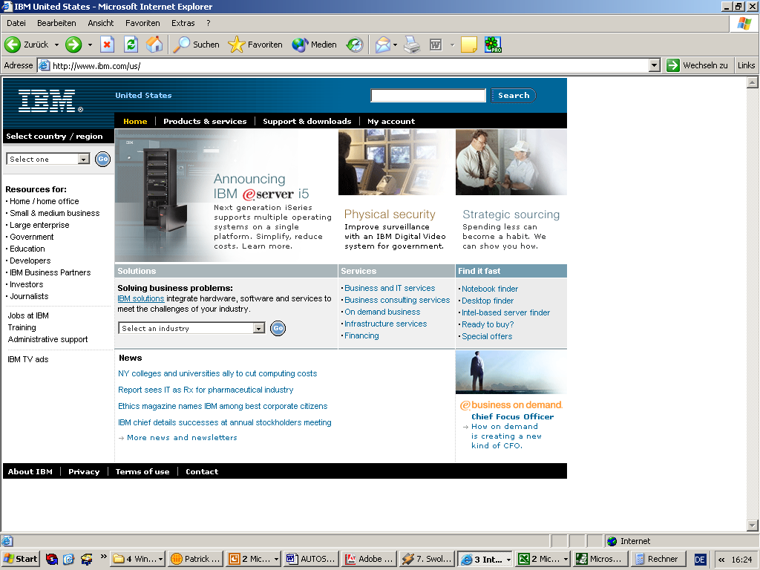









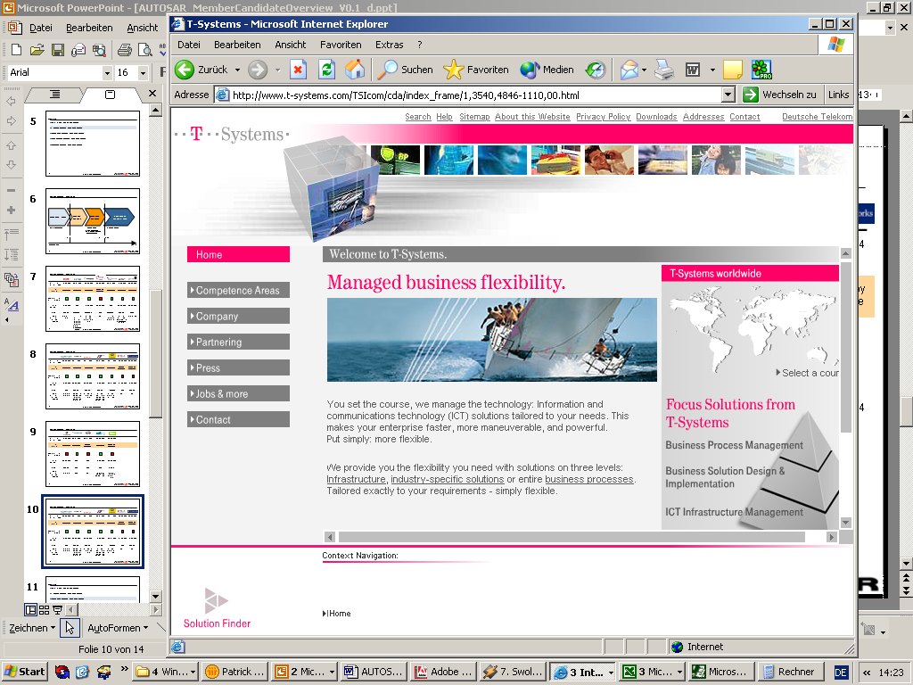








What is AUTOSAR
AUTOSAR partnership
10 Core Partners
48 Associate
Members
CapeWare
52 Premium Members
OEM
Tier 1
Standard Software
Tools
Semi- conductors
Source:

Slide 162
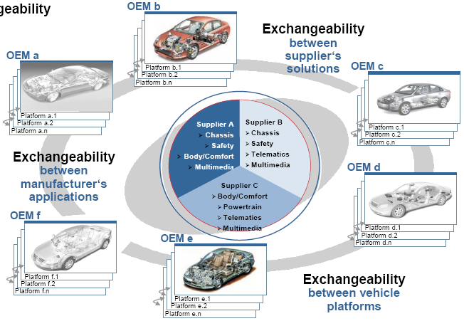
What is AUTOSAR
AUTOSAR Project Objectives
AUTOSAR vision is an improved complexity management of highly integrated E/E architectures through an increased reuse of SW modules between OEM and suppliers.

Slide 163
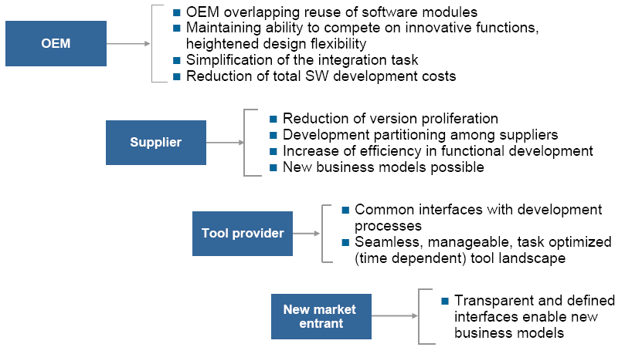
What is AUTOSAR
Benefits from AUTOSAR

Slide 164
AUTOSAR from a Technical Point of View
AUTOSAR Layered Architecture
AUTOSAR
Software
Component
Application
Software
Component
Actuator
Software
Component
Sensor
Software
Component
Application
Software
Component
AUTOSAR Software
Interface
AUTOSAR Interface
AUTOSAR Interface
AUTOSAR Interface
AUTOSAR Interface
..............
AUTOSAR Runtime Environment (RTE)
ECU
Firmware
Standardized Interface
Standardized AUTOSAR Interface
Standardized Interface
AUTOSAR Interface
AUTOSAR Interface
Standard
Software
Operating
System
Services
Communication
ECU
Abstraction
Complex
Device
Drivers
API 2 VFB & RTE
relevant
Standardized Interface
Standardized Interface
Standardized Interface
API 1
RTE
relevant
Standardized Inteface
Standardized Interface
API 0
Basic Software
Microcontroller Abstraction
API 3 Private
Interfaces inside Basic Software
possible
ECU-Hardware
Notes:
RTE :
- Configurator
- Software Components
OS :
- OSEK OS
- AUTOSAR OS (Scheduling, Monitoring, Protection, Timer, Time triggered)
- Configurator
Service
- Diagnostic
- Memory
- System (Watchdog, ECU State manager, CRC, …)
- XML Description
Communication
- CAN, LIN, FlexRay, etc Components (기존)
- AUTOSAR IF 개발(DGIST)
- XML Description
MAL :
- Low-level device driver (반도체)
- AUTOSAR IF 개발(DGIST)
- XML Description
EAL :
- AUTOSAR IF 개발(DGIST)
- XML Description

Slide 165
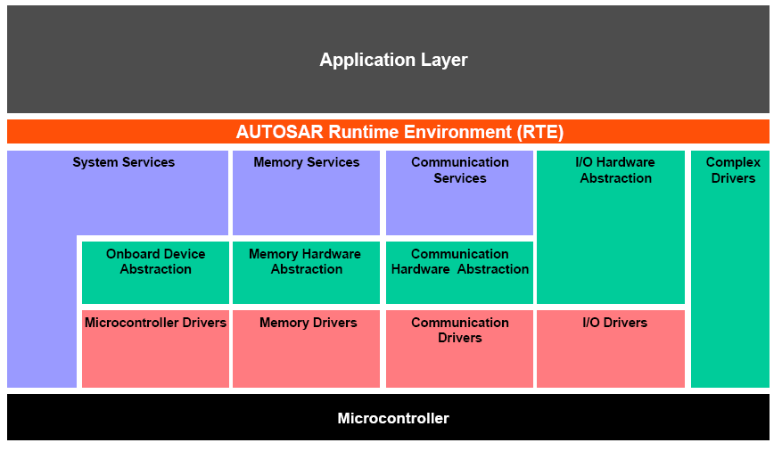
AUTOSAR from a Technical Point of View
AUTOSAR Layered Architecture

Slide 166
AUTOSAR from a Technical Point of View
Derive E/E architecture from formal descriptions of Sw. & Hw. components
Functional software is described formally in terms of “software Components” (SW-C).
Using “Software Component Descriptions” as input, the “Virtual Functional Bus” validates the interaction of all components and interfaces before software implementation.
Mapping of “Software Components” to ECUs and configuration of basic software.
The AUTOSAR Methodology supports the generation of an E/E architecture.

Slide 167
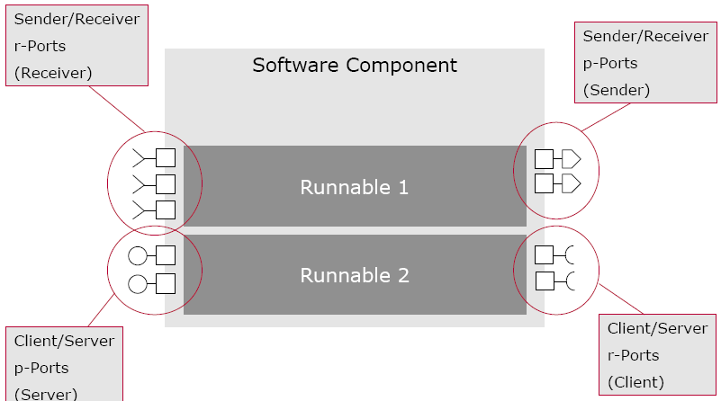
AUTOSAR from a Technical Point of View
AUTOSAR SW-C (Software Component)
Application is divided into SW-Cs.
Software Components consist of
Ports
Interface to other SW-Cs
Runnable Entities (or Runnables)
Procedures which contain the actual implementation
Triggered cyclically or on event (e.g. data reception)
Other software components
Composite components for hierarchical design
Three types of SW-C
Atomic SW-C
Composite SW-C
Sensor/Actuator SW-C

Slide 168
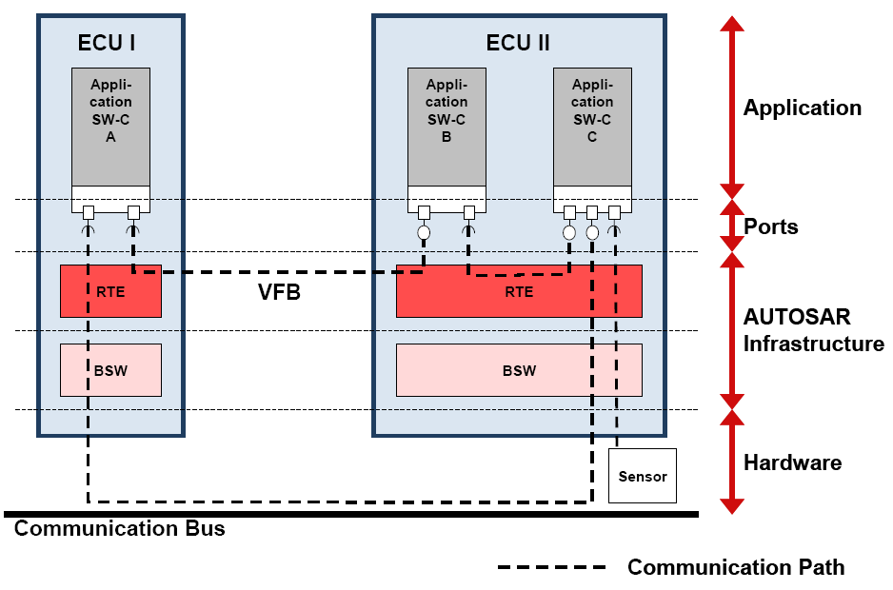
AUTOSAR from a Technical Point of View
RTE (Runtime Environment)
Implementation of Virtual Functional Bus
Interface between SW-Cs and Basic Software
All calls to basic software pass through the RTE
Communication method : Send/Receive signals, Client/Server functionality
Triggering of runnables : Cyclically or On event

Slide 169
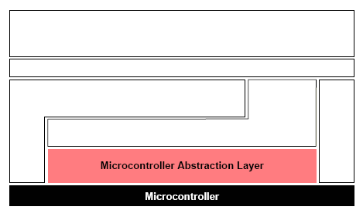
AUTOSAR from a Technical Point of View
MCAL (Microcontroller Abstraction Layer)
MCAL is the lowest software layer of the Basic Software
It contains internal drivers, which are software modules with direct access to the microcontroller internal peripherals and memory mapped microcontroller external devices
Make higher software layers independent of microcontroller

Slide 170
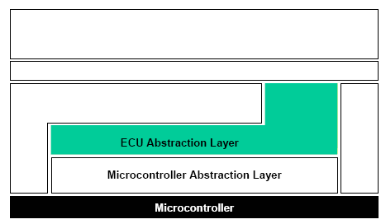
AUTOSAR from a Technical Point of View
EAL (ECU Abstraction Layer)
The EAL interfaces the drivers of the MACL
It also contains drivers for external devices
It offers an API for access to peripherals and divides regardless of their location and their connection to the microcontroller (port pins, type of interface)
Make higher software layers independent of ECU hardware layout

Slide 171
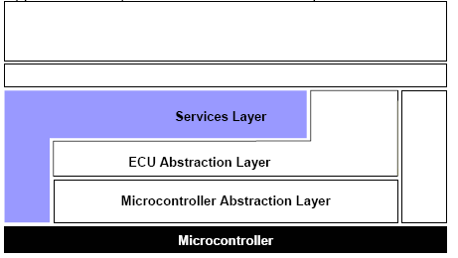
AUTOSAR from a Technical Point of View
Services Layer
Services Layer is the highest layer of the Basic software which also applies for its relevance for the application software
The Services layer offers
Operating system functionality
Vehicle network communication and management services
Memory services (NVRAM management)
Diagnostic services
ECU state management
Provide basic services for application and Basic Software modules

Slide 172
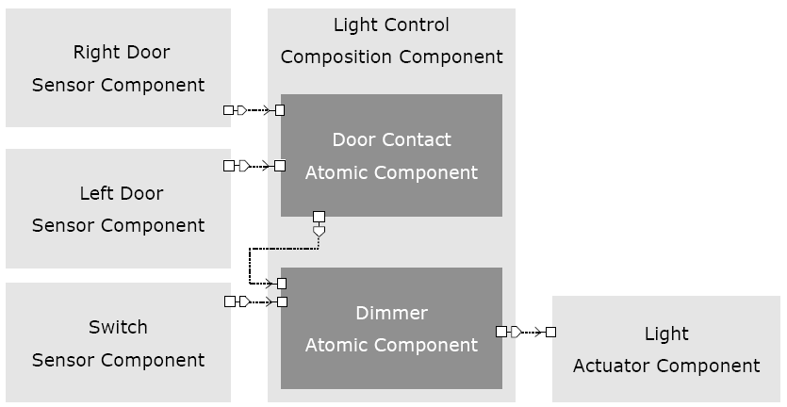
Example AUTOSAR System : Lighting System
Software Component View

Slide 173
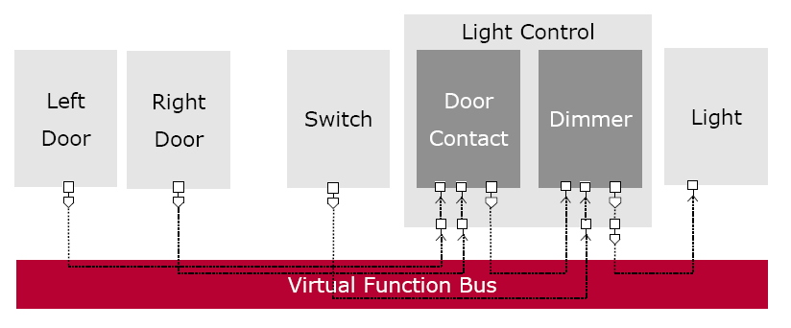
Example AUTOSAR System : Lighting System
Virtual Functional Bus View

Slide 174
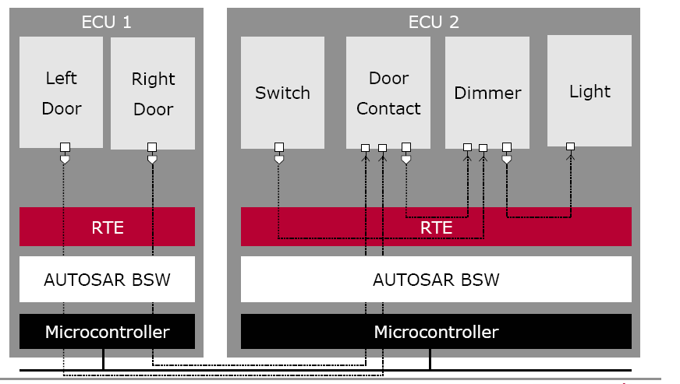
Example AUTOSAR System : Lighting System
Mapped System

Slide 175
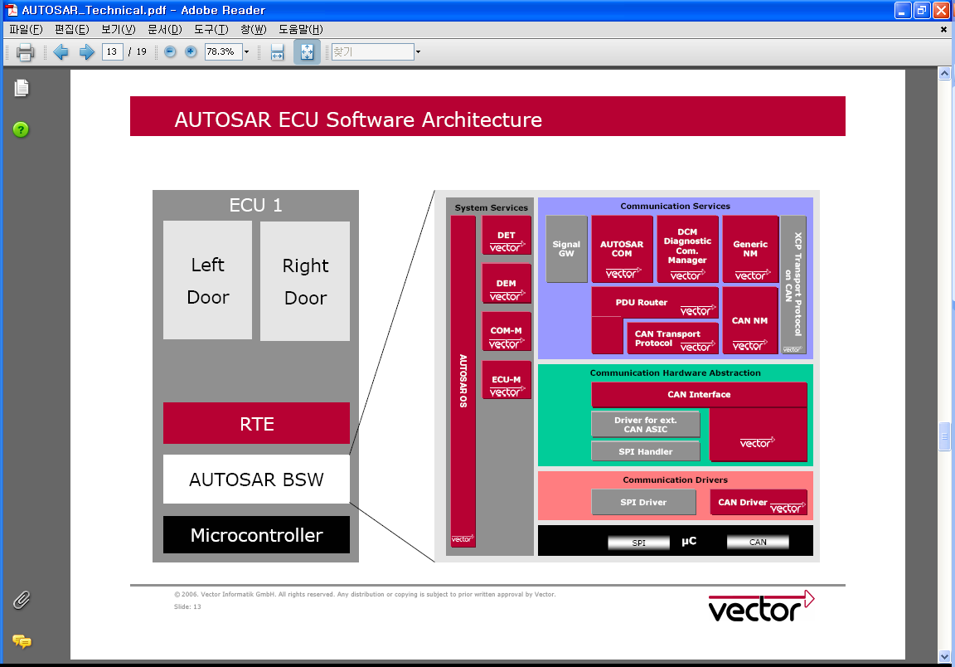
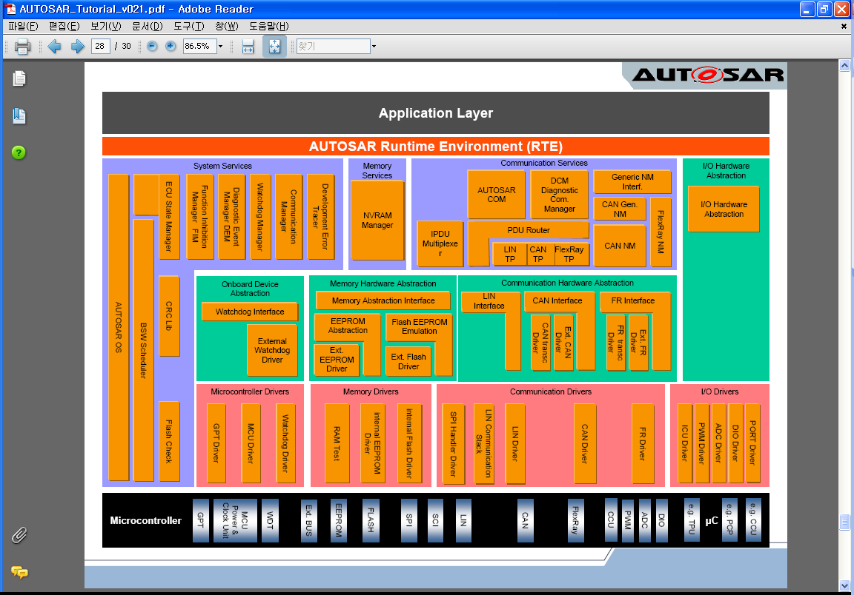
Example AUTOSAR System : Lighting System
Basic Software Architecture

Slide 176
Other ADLs …
MetaH
Developed by Honeywell, a domain specific ADL aimed at guidance, navigation, and control applications with ControlH
Sophisticated tool support available
C2 SADL
Developed by Taylor/Medvidovic (UCI), style specific ADL, emphasis on dynamism
Still in prototype stage
SADL
Developed by Moriconi and Riemenschneider (SRI), emphasis on refinement mappings

Slide 177
UML as an ADL
The Positive
lowers entry barrier, mainstreams modeling, tools
Shortcomings of UML as an ADL
Weakly integrated models with inadequate semantics for (automated) analysis
Connectors are not first class objects
Visual notation with little generation support, hidden and ambiguous relationships between views, both too much and too little

Slide 178
In Summary: Approaches to Architecture Description
Academic Approach
focus on analytic evaluation of architectural models
individual models
rigorous modeling notations
powerful analysis techniques
depth over breadth
special-purpose solutions
Industrial Approach
focus on wide range of development issues
families of models
practicality over rigor
architecture as the “big picture” in development
breadth over depth
general-purpose solutions
Source: N. Medvidovic, USC

Slide 179
Conclusions
There is a rich body of research to draw upon... Old but still active!
Much has been learned about representing and analyzing architectures
Effort is needed now to bring together the common knowledge and put it into practice

Slide 180
Don’t Forget!
On Nov. 9th we will have our 1st project revision!
Prepare a presentation:
20 mins + questions
You will HAVE TO expose, at least:
(a) the architecture and organisational structure of the community and product;
(b) the properties and visible features of the architecture;
(c) the limitations and shortcomings of that product, how to install/interact with it;
You MAY want to use the concepts and notations we used up to this point;

Slide 181
For More Information
ACME: http://www.cs.cmu.edu/~acme
Rapide: http://pavg.stanford.edu/rapide/
Wright: http://www.cs.cmu.edu/afs/cs/project/able/www/wright/index.html
Aesop: http://www.cs.cmu.edu/afs/cs/project/able/www/aesop/aesop_home.html
Unicon: http://www.cs.cmu.edu/afs/cs/project/vit/www/unicon/index.html
C2 SADL: http://www.ics.uci.edu/pub/arch/
SSEP: http://www.mcc.com/projects/ssepp
ADML: http://www.mcc.com/projects/ssepp/adml
A possibly more current version of this presentation can be found at: http://www.mcc.com/projects/ssepp/adml/tog

Slide 182
References (Architecture)
Len Bass, Paul Clements & Rick Kazman, Software Architecture in Practice, Addison-Wesley, 1998.
Frank Buschmann, Régine Meunier, Hans Rohnert, Peter Sommerlad, and Michael Stahl, Pattern-Oriented Software Architecture - A System of Patterns, Wiley and Sons, 1996.
Christine Hofmeister, Robert Nord, Dilip Soni, Applied Software Architecture, Addison-Wesley 1999.
Eric Gamma, John Vlissides, Richard Helm, Ralph Johnson, Design Patterns, Addison-Wesley 1995.
Philippe Kruchten, “The 4+1 View Model of Architecture,” IEEE Software, 12 (6), November 1995, IEEE.
http://www.rational.com/support/techpapers/ieee/
Eberhardt Rechtin, Systems Architecting: Creating and Building Complex Systems, Englewood Cliffs NJ, Prentice-Hall, 1991.

Slide 183
References (Architecture)
Eberhardt Rechtin & Mark Maier, The Art of System Architecting, CRC Press, 1997.
Recommended Practice for Architectural Description, Draft 2.0 of IEEE P1471, May 1998
http://www.pithecanthropus.com/~awg/
Mary Shaw, and David Garlan, Software Architecture—Perspectives on an Emerging Discipline, Upper Saddle River, NJ, Prentice-Hall, 1996.
Bernard I. Witt, F. Terry Baker, and Everett W. Merritt, Software Architecture and Design—Principles, Models, and Methods, New York NY, Van Nostrand Reinhold, 1995.
The World-wide Institute of Software Architects
http://www.wwisa.org

Slide 184
References (UML4Arch)
Grady Booch, James Rumbaugh, Ivar Jacobson, The Unified Modeling Language User Guide, Addison-Wesley, 1999.

Slide 185



10 min break?

